Slide 1
Web Technologies Concepts

Slide 2
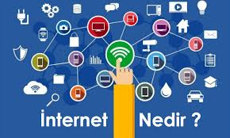
What is Internet?
A network is a group of connected, communicating devices such as computers and printers,
The Internet is essentially a global network of computing resources. You can think of the Internet as a physical collection of routers as a set of shared resources.
Internet is two or more networks that can communicate with each other (composed of hundreds of thousands of interconnected networks)
A network of networks based on the TCP/IP communications protocol.

Slide 3
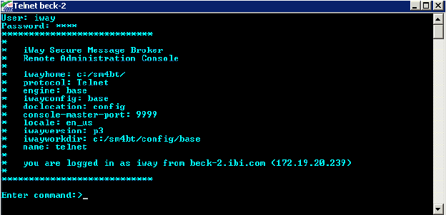
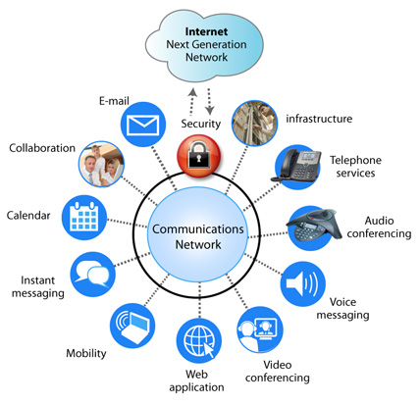
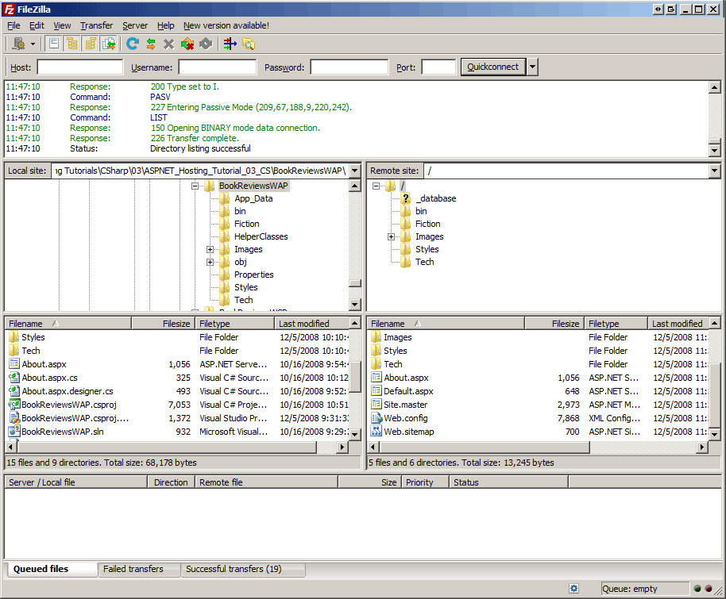
Internet-Based Services
Email − A fast, easy, and inexpensive way to communicate with other Internet users around the world.
Telnet − Allows a user to log into a remote computer as though it were a local system. (TCP 23 or 2323)
FTP − Allows a user to transfer virtually every kind of file that can be stored on a computer from one Internet-connected computer to another. (TCP 21)
World Wide Web (WWW) − A hypertext interface to Internet information resources. (80 for http; 443 for https)

Slide 4
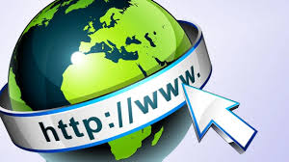
What is WWW?
WWW stands for World Wide Web. A technical definition of the World Wide Web is − All the resources and users on the Internet that are using the Hypertext Transfer Protocol (HTTP).
A broader definition comes from the organization that Web inventor Tim Berners-Lee helped found, the World Wide Web Consortium (W3C): The World Wide Web is the universe of network-accessible information, an embodiment of human knowledge.
In simple terms, The World Wide Web is a way of exchanging information between computers on the Internet, tying them together into a vast collection of interactive multimedia resources.

Slide 5
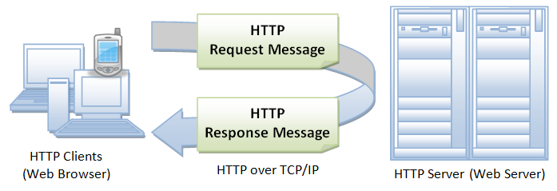
What is HTTP?
HTTP stands for Hypertext Transfer Protocol. This is the protocol being used to transfer hypertext documents that makes the World Wide Web possible.
Hypertext is text displayed on a computer display or other electronic devices with references (hyperlinks) to other text that the reader can immediately access.
Hypertext documents are interconnected by hyperlinks, which are typically activated by a mouse click, keypress set, or screen touch.
A standard web address such as http://www.yahoo.com is called a URL and here the prefix http indicates its protocol.

Slide 6
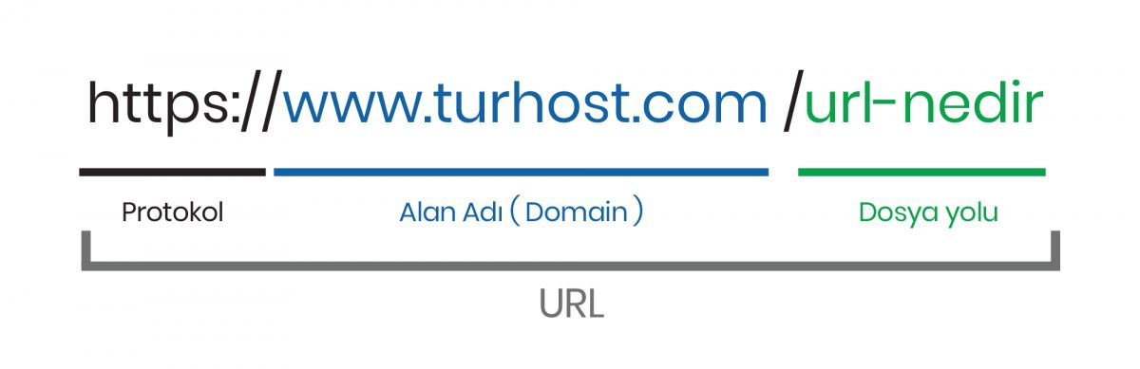
What is URL?
URL stands for Uniform Resource Locator, and is used to specify addresses on the World Wide Web. A URL is the fundamental network identification for any resource connected to the web (e.g., hypertext pages, images, and sound files).
A URL will have the following format
protocol://hostname/other_information
http://www.example.com/index.html
https://www.linux.org/
http://www.example.com/questions/3456/my-document
The protocol is followed by a colon, two slashes, and then the domain name. The domain name is the computer on which the resource is located.
Links to particular files or subdirectories may be further specified after the domain name. The directory names are separated by single forward slashes.
The protocol specifies how information is transferred from a link. The protocol used for web resources is HyperText Transfer Protocol (HTTP). Other protocols compatible with most web browsers include FTP, telnet, POP3, ...
https://www.hostinger.com/tutorials/what-is-a-url

Slide 7
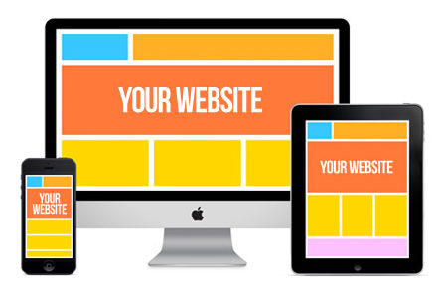
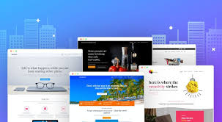
What is Website?
A website, which is a collection of various pages written in HTML markup language where people can find information on various topics. Similarly, there are millions of websites available on the web.
Each page available on the website is called a web page and first page of any website is called home page for that site with different file extensions (index.htm, default.htm, index.php, default.asp/x)

Slide 8
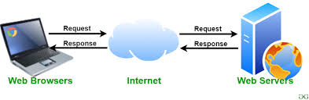
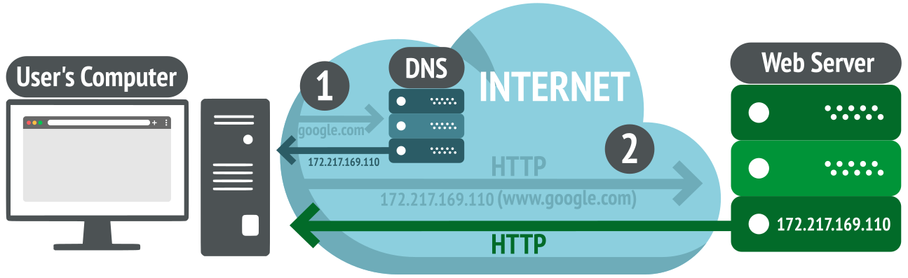
What is Web Server?
Every Website sits on a computer known as a Web server. This server is always connected to the internet. Every Web server that is connected to the Internet is given a unique address made up of a series of four numbers between 0 and 256 separated by periods. For example, 68.178.157.132 or 68.122.35.127.
When you register a Web address, also known as a domain name, such as tutorialspoint.com you have to specify the IP address of the Web server that will host the site.

Slide 9
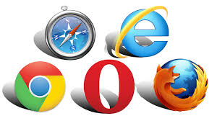
What is Web Browser?
Web Browsers are software installed on your PC. To access the Web you need a web browser, such as Netscape Navigator, Microsoft Internet Explorer or Mozilla Firefox.
Currently you must be using any sort of Web browser while you are navigating through this site. On the Web, when you navigate through pages of information this is commonly known as browsing or surfing.
https://www.youtube.com/watch?v=W4wWdmfOibY

Slide 10
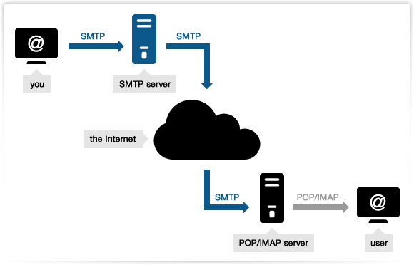
What is SMTP Server?
SMTP stands for Simple Mail Transfer Protocol Server. This server takes care of delivering emails from one server to another server. When you send an email to an email address, it is delivered to its recipient by a SMTP Server.

Slide 11
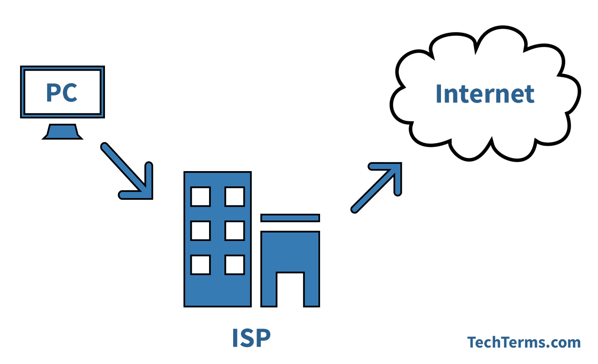
What is ISP?
ISP stands for Internet Service Provider. They are the companies who provide you service in terms of internet connection to connect to the internet.

Slide 12
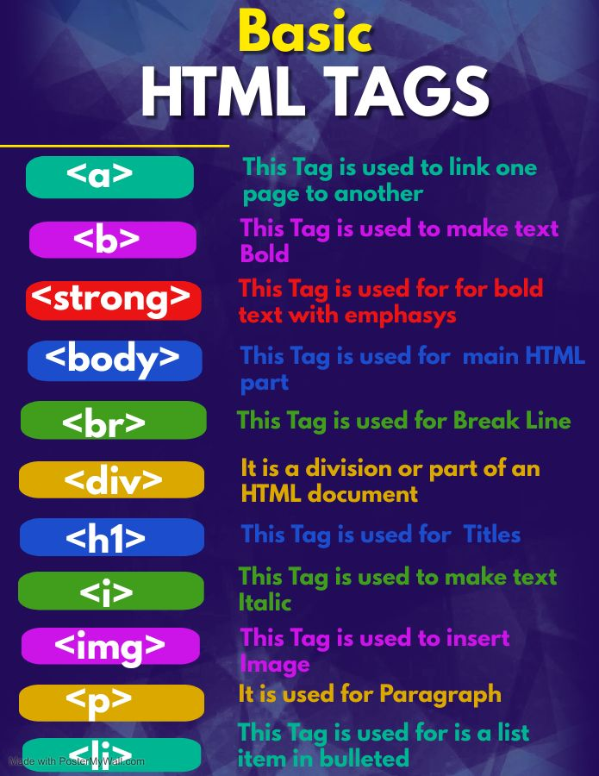
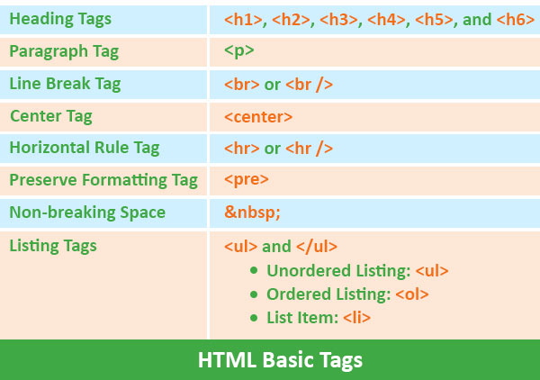
What is HTML?
HTML stands for Hyper Text Markup Language. This is the language in which we write web pages for any Website. Even the page you are reading right now is written in HTML.
HTML has commands named tags.
Most of the tags are used in pairs.
<b>Hello</b>

Slide 13
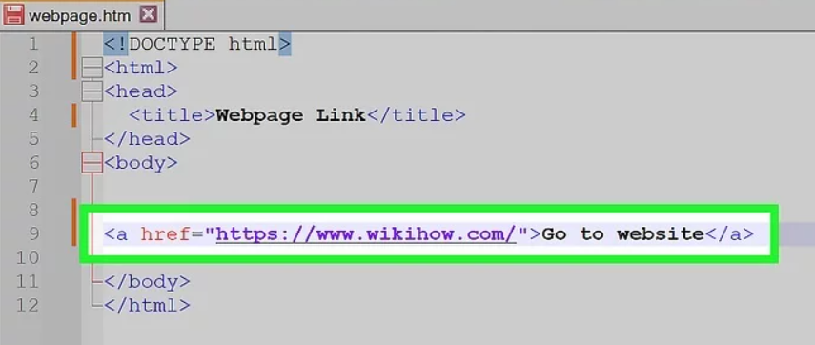
What is Hyperlink?
A hyperlink or simply a link is a selectable element in an electronic document that serves as an access point to other electronic resources.
Typically, you click the hyperlink to access the linked resource. Familiar hyperlinks include buttons, icons, image maps, and clickable text links.

Slide 14
What is DNS?
DNS stands for Domain Name System.
When someone types in your domain name, www.example.com, your browser will ask the Domain Name System to find the IP that hosts your site.
When you register your domain name, your IP address should be put in a DNS record along with your domain name. Without doing it your domain name will not be functioning properly.

Slide 15
What is W3C?
W3C stands for World Wide Web Consortium which is an international consortium of companies involved with the Internet and the Web.
The W3C was founded in 1994 by Tim Berners-Lee, the original architect of the World Wide Web.
The organization's purpose is to develop open standards so that the Web evolves in a single direction rather than being splintered among competing factions. The W3C is the chief standards body for HTTP and HTML.

Slide 16
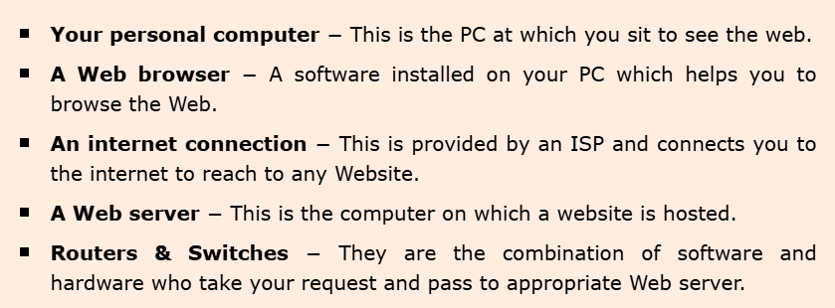
Web - How it Works ?
On the simplest level, the Web physically consists of the following components −

Slide 17
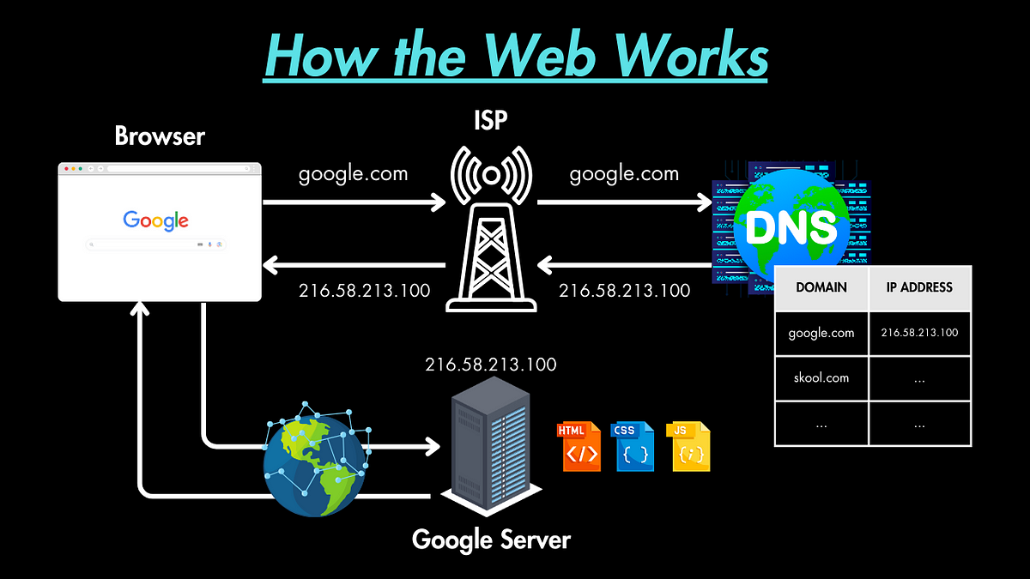
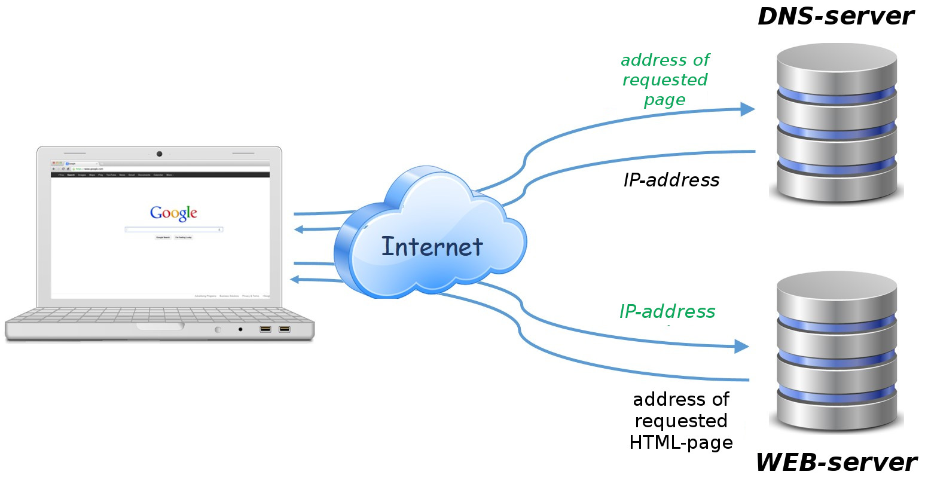

Slide 18
Web - Browser Types
Web Browsers are software installed on your PC. To access the Web, you need a web browser, such as Netscape Navigator, Microsoft Internet Explorer or Mozilla Firefox.
There are four leading web browsers − Explorer, Firefox, Netscape, and Safari, but there are many others browsers available. You might be interested in knowing Complete Browser Statistics.

Slide 19
Web - Server Types
Every Website sits on a computer known as a Web server. This server is always connected to the internet. Every Web server that is connected to the Internet is given a unique address made up of a series of four numbers between 0 and 255 separated by periods. For example, 68.178.157.132 or 68.122.35.127.
There are four leading web servers − Apache, IIS, lighttpd and Jagsaw.
Apart from these Web Servers, there are other Web Servers also available in the market but they are very expensive. Major ones are Netscape's iPlanet, Bea's Web Logic and IBM's WebSphere.

Slide 20
Web - Site Advantages
Business is Open 24x7
This means that once you put your business onsite, then your business is open 7 days a week and 365 days a year. Even if you are in different locations of the world then you will be able to serve your customers on 24x7 hours basis.
Increased Customer Base
Because anyone in the world can see your website so you will gain customers from other states and countries while you are putting in the same amount of effort and money.
Tremendous Cost Saving
This is one of the biggest advantages of having a business online. You do not need to keep a big man power and lot of resources to maintain a business on site. There are many other cost saving opportunities while keeping business online. Think of how many cards you mail out to let customers know about your sale. All of that can be eliminated by putting the sale information on your website and inviting your customers to visit it.

Slide 21
Web - Site Advantages
Advertising Opportunities
Apart from saving your advertising cost, you have additional opportunities to run advertisements from other companies and start making money. If you ever advertised in a local newspaper, you know the costs. You are being charged per line, per inch, and per color. On the Web, there is no limit to how much you can put. So whenever there is a new product or service, then you can advertise it in a better way.
Creates a Brand Image
Internet is a great medium through which you can create any image of yourself which you want. It is all in your hands. For example, you can design a professional website, add helpful content, and your company will immediately take a step up in the image it represents. No matter how small your business is, with the right tools and a great desire you can make it look like a corporation on the Web.
Customer Satisfaction
If you have a really good site online, then you can give your customers a lot of satisfaction in terms of customer care. You can keep online help, FAQ, and other important information which is useful for your customers. You can create online forums for open discussion and you can conduct customer survey to take customer feedback etc.

Slide 22
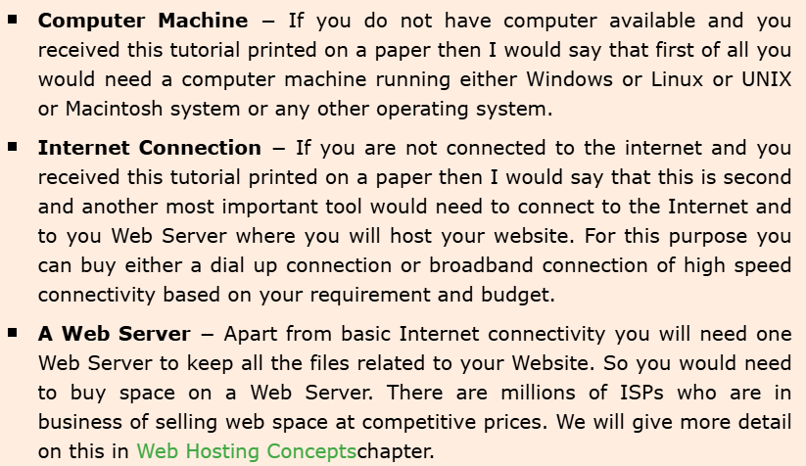
Web - Tools Required

Slide 23
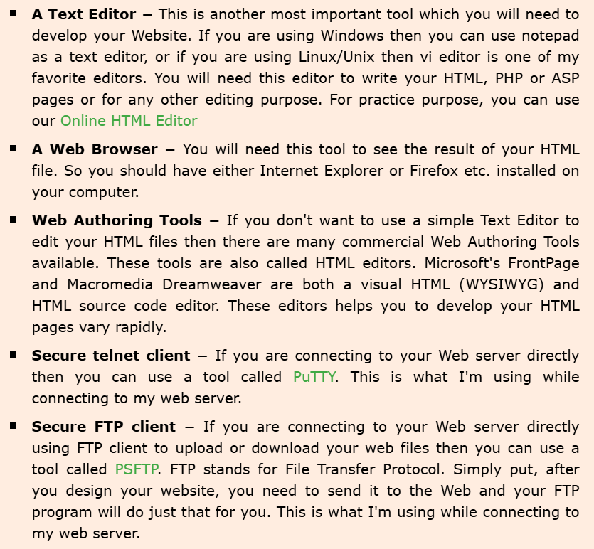

Slide 24
Web - Domain Names
How to Get a Domain Name?
When you plan to put a site online, this is one of the important steps to buy a domain name. This is always not necessary that whatever domain name you are looking that is available so in that case you will have to opt for any other good domain name.
When you buy a domain name it is registered and when domain names are registered they are added to a large domain name register, and information about your site − including your Internet IP address is stored on a DNS server and your contact information etc. is registered with your registrar.
You can buy domain name from any domain registrar like GoDaddy

Slide 25
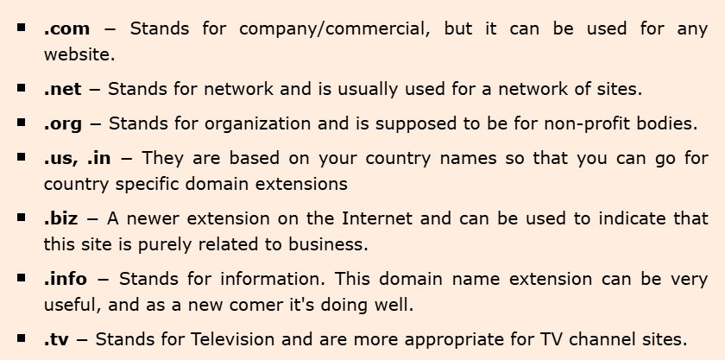
https://mailchimp.com/resources/domain-extensions/

Slide 26
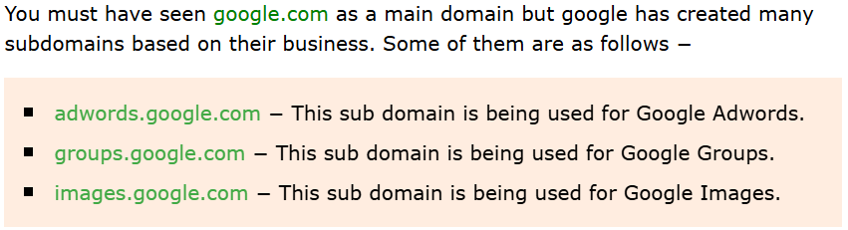
What are Sub-Domains?
You can divide your domain into many sub domains based on your requirement. If you are doing multiple business using the same domain, then it would be useful to have sub-domains for every business. Following are examples of some sub-domains −

Slide 27
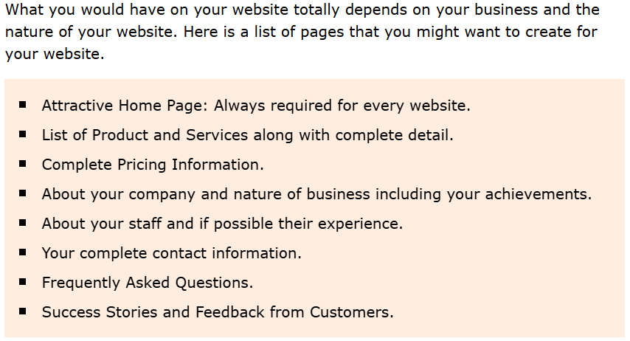
What to Put on Your Website?

Slide 28
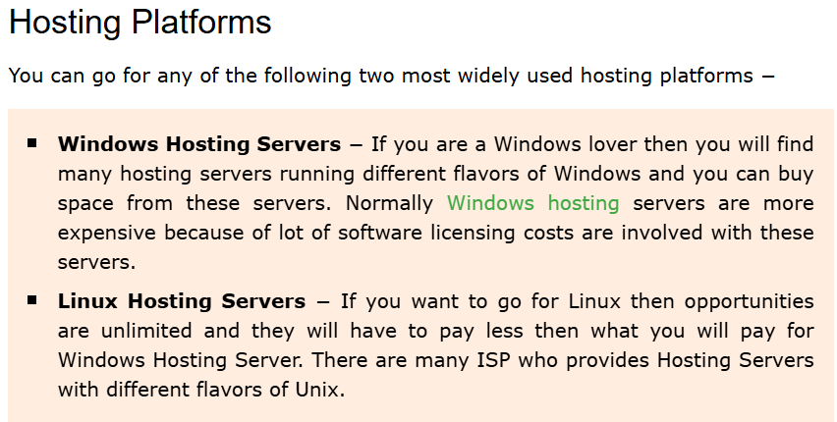
Web - Hosting Concepts
Buying a server space or renting a complete server from an Internet Service Provider (ISP) is the most widely used option

Slide 29
Web Versions-Web 1.0 (Static Web)
Meaning: Web 1.0 refers to the early version of the internet, around the 1990s to early 2000s. This version was characterized by static web pages that displayed content without much interaction or change.
Features:
Static Pages: Websites were built with HTML and had fixed content that could not be altered by users.
Passive Users: Users could only consume content, not interact with it (no comments, no content creation).
Basic Design: Websites were simple with minimal graphics and design features.
Example Applications:
Personal Websites: Simple sites for sharing personal information.
News Websites: Early static websites like older versions of CNN or BBC.

Slide 30
Web 2.0 (Dynamic Web and Social Web)
Meaning: Web 2.0 emerged around 2004 and focused on interactivity and social aspects. It allowed users not only to consume content but also to create and share content, marking a shift from static to dynamic websites.
Features:
Dynamic Content: Websites could update and change based on user interaction.
Social Media: Users could interact with each other, share content, and comment.
Rich User Experience: Technologies like Flash, AJAX, and JavaScript made web interactions faster and more dynamic.
Example Applications:
Social Media Platforms: Facebook, Twitter, Instagram (where users create and share content).
Wikipedia: A collaborative encyclopedia where users can add and edit content.
YouTube: A video-sharing platform where users can upload and comment on videos.

Slide 31
Web 3.0 (Semantic Web)
Meaning: Web 3.0, also known as the Semantic Web, began to take shape around the late 2000s. It aims to make web data more understandable by machines, creating a more intelligent and personalized web experience by using artificial intelligence (AI) and machine learning.
Features:
Semantic Web: Data is structured so that it can be easily understood and processed by machines.
AI and Machine Learning: The web learns from user behavior to offer more personalized content and suggestions.
Decentralization: Blockchain and decentralized technologies allow for more secure, transparent, and user-controlled data.
Example Applications:
AI Assistants: Siri, Alexa, and Google Assistant that understand user intent and context.
Blockchain Applications: Cryptocurrencies like Bitcoin and Ethereum that are decentralized.
Semantic Search: Google’s search engine becoming smarter in understanding queries and providing more relevant results.

Slide 32
Web 4.0 (Connected and Fully Intelligent Web)
Meaning: Web 4.0 is a concept for the future of the internet, although it’s still emerging. This version aims to create a more connected, intelligent web that can seamlessly interact with users and devices, offering a fully immersive and pro-active experience.
Features:
Advanced AI: Web 4.0 will have even more advanced artificial intelligence to offer highly personalized and anticipatory experiences.
Internet of Things (IoT): Devices and sensors are interconnected, sharing data in real time to create smarter environments.
Continuous Evolution: Web 4.0 will continuously learn from user interactions and adapt to provide more effective solutions.
Example Applications:
Smart Homes (IoT): Devices in homes that are interconnected and adjust based on user preferences (like smart thermostats, lights, etc.).
Advanced Personal Assistants: AI systems that predict user needs and provide proactive suggestions or actions.
Automated Content Creation: Websites and platforms that automatically generate content based on user interactions.

Slide 33
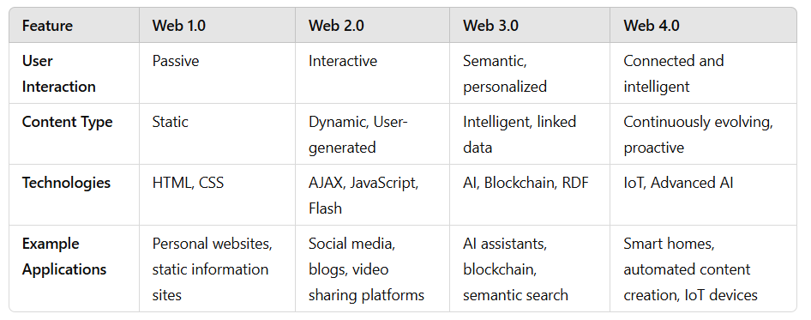

Slide 34
Key Differences:
Web 1.0 is mostly informational with static pages, focusing on content consumption.
Web 2.0 introduces interactivity, allowing users to create, share, and engage with content.
Web 3.0 focuses on making data more meaningful with AI and decentralized technologies, offering a more personalized and secure web experience.
Web 4.0 envisions a highly intelligent, connected web, where AI and IoT devices work seamlessly to predict and enhance user experiences.

Slide 35
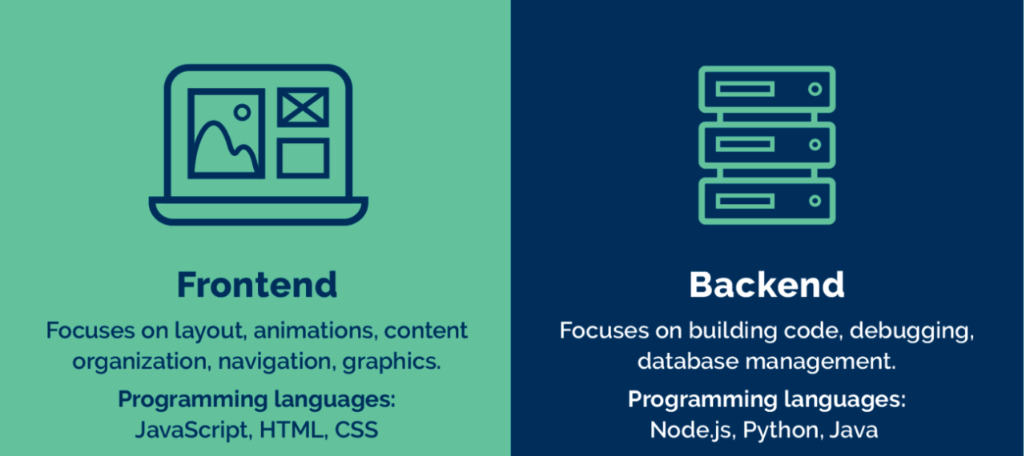
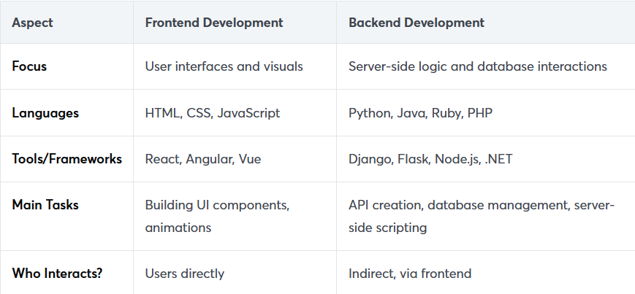
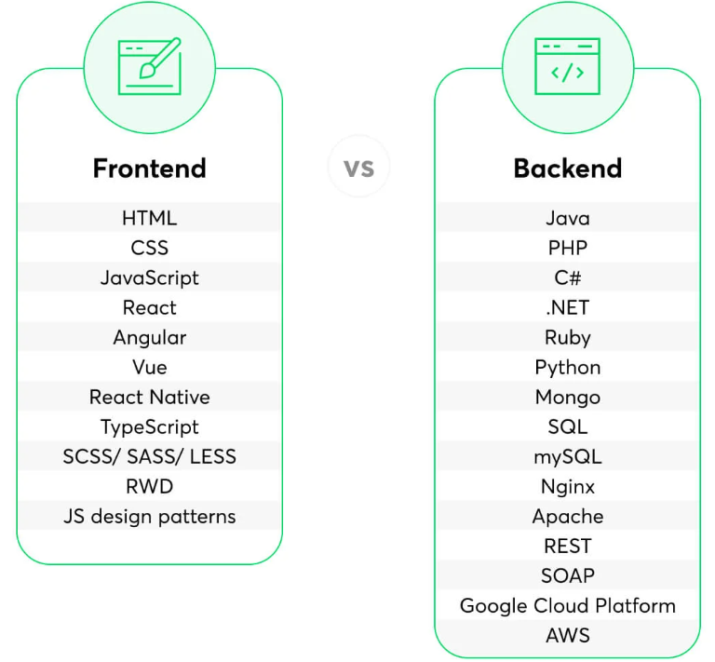
https://www.netguru.com/blog/front-end-vs-back-end-development
https://www.extwebtech.com/blog/front-end-vs-back-end-web-development/

Slide 36
References
https://www.tutorialspoint.com/web_developers_guide/index.htm

