Slide 1
OperatIng Systems
H.Bodur

Slide 2
Protection and Security in Operating System
Protection and security require that computer resources such as CPU, softwares, memory etc. are protected. This extends to the operating system as well as the data in the system. This can be done by ensuring integrity, confidentiality and availability in the operating system. The system must be protected against unauthorized access, viruses, worms etc.

Slide 3
Protection
Protection tackles the system's internal threats. It provides a mechanism for controlling access to processes, programs, and user resources. In simple words, it specifies which files a specific user can access or view and modify to maintain the proper functioning of the system. It allows the safe sharing of common physical address space or common logical address space which means that multiple users can access the memory due to the physical address space.

Slide 4
Protection
Let's take an example for a better understanding, suppose in a small organization there are four employees personal1, personal2, personal3, personal4, and two data resources source1 and source2. The various departments frequently exchange information but not sensitive information between all employees. The employees personal1 and personal2 can only access source1 data resources and employees personal3 and personal4 can only access source2 resources. If the employee personal1 tries to access the data resource source2, then the employee personal1 is restricted from accessing that resource. Hence, personal1 will not be able to access the source2 resource.

Slide 5
Security
Security tackles the system's external threats. The safety of their system resources such as saved data, disks, memory, etc. is secured by the security systems against harmful modifications, unauthorized access, and inconsistency. It provides a mechanism (encryption and authentication) to analyze the user before allowing access to the system.

Slide 6
Security
As discussed in the previous example, In the organization data resources are shared with many employees but a user who does not work for that specific company cannot access this information. Security can be achieved by three attributes: confidentiality (prevention of unauthorized resources and modification), integrity (prevention of all unauthorized users), and availability (unauthorized withholding of resources).

Slide 7
Difference between Protection and Security
Protection | Security
Protection deals with who has access to the system resources. | Security gives the system access only to authorized users.
Protection tackles the system's internal threats. | Security tackles the system's external threats.
Protection addresses simple queries. | More complex queries are addressed in security.
It specifies which files a specific user can access or view and modify. | It defines who is permitted to access the system.
An authorization mechanism is used in protection. | Encryption and certification (authentication) mechanisms are implemented.
Protection provides a mechanism for controlling access to processes, programs, and user resources. | While security provides a mechanism to safeguard the system resources and the user resources from all external users.

Slide 8
Threats to Protection and Security
A program that is malicious in nature and has harmful impacts on a system is called a threat. Protection and security in an operating system refer to the measures and procedures that can ensure the confidentiality, integrity, and availability of operating systems. The main goal is to protect the OS from various threats, and malicious software such as trojans, worms, and other viruses, misconfigurations, and remote intrusions.
Some of the common threats that occur in a system are:

Slide 9
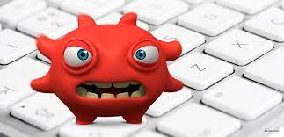
Virus
Viruses are generally small snippets of code embedded in a system. They are very dangerous and can corrupt files, destroy data, crash systems etc. They can also spread further by replicating themselves as required. For instance, you could receive an email with a malicious attachment, open the file unknowingly, and then the computer virus runs on your computer. Viruses are harmful and can destroy data, slow down system resources, and log keystrokes.

Slide 10
Virus vs. malware – what is the difference?
The terms “virus” and “malware” are often used interchangeably, but they’re not the same thing. While a computer virus is a type of malware, not all malware are computer viruses.
The easiest way to differentiate computer viruses from other forms of malware is to think about viruses in biological terms. Take the flu virus, for example. The flu requires some kind of interaction between two people—like a hand shake, a kiss, or touching something an infected person touched. Once the flu virus gets inside a person’s system it attaches to healthy human cells, using those cells to create more viral cells.

Slide 11
Virus vs. malware – what is the difference?
A computer virus works in much the same way:
A computer virus requires a host program.
A computer virus requires user action to transmit from one system to another.
A computer virus attaches bits of its own malicious code to other files or replaces files outright with copies of itself.
It’s that second virus trait that tends to confuse people. Viruses can’t spread without some sort of action from a user, like opening up an infected Word document. Worms, on the other hand, are able to spread across systems and networks on their own, making them much more prevalent and dangerous.

Slide 12

Trojan Horse
Trojans can be viruses. A Trojan is a computer program pretending to be something it’s not for the purposes of sneaking onto your computer and delivering some sort of malware. To put it another way, if a virus disguises itself then it’s a Trojan. A Trojan could be a seemingly benign file downloaded off the web or a Word doc attached to an email.
A trojan horse can secretly access the login details of a system. Then a malicious user can use these to enter the system as a harmless being.

Slide 13
Prevention of Trojan horse
There are certain things needs that need to be followed for the user. They are avoiding clicking links from unknown resources. Access the URL that only starts with HTTP. The links received through emails or text messages are not advised to open directly. Before logging into any website, use their official sites to login using the credentials. The Password must be strong and same password should not be followed for all pages.

Slide 14
Trap Door
The trap door is also known as the back door. In which, the Programmer designs a security or secret code that gives a threat to the system. The trap door program threat is one in which the designer keeps a hole in the program, so it can be handled only by the designer. So, it is very difficult to track or find the hole in the program and need to go through the entire source code. This security hole helps the designer access that system. When the system is in an abnormal state, if we take data backup it also contains hidden threats.

Slide 15
Trap Door Purpose
The Legitimate use of trap door threat is the designers don’t actually create a hole or security code, but instead, they leave the space in the code. These blanks are used by the technicians for the emergency purpose of handling the data. The trap door is a kind of secret password used by developers for maintenance purposes.

Slide 16
Effects of Security
The effects of the trapdoor can be easily identified by persons who know the flow of the trapdoor and its vulnerability. Software vendors know the threats of trapdoors and the ways to avoid them, but nowadays users identify the threats and solve themselves without informing about the trap door threats to the specialists.

Slide 17
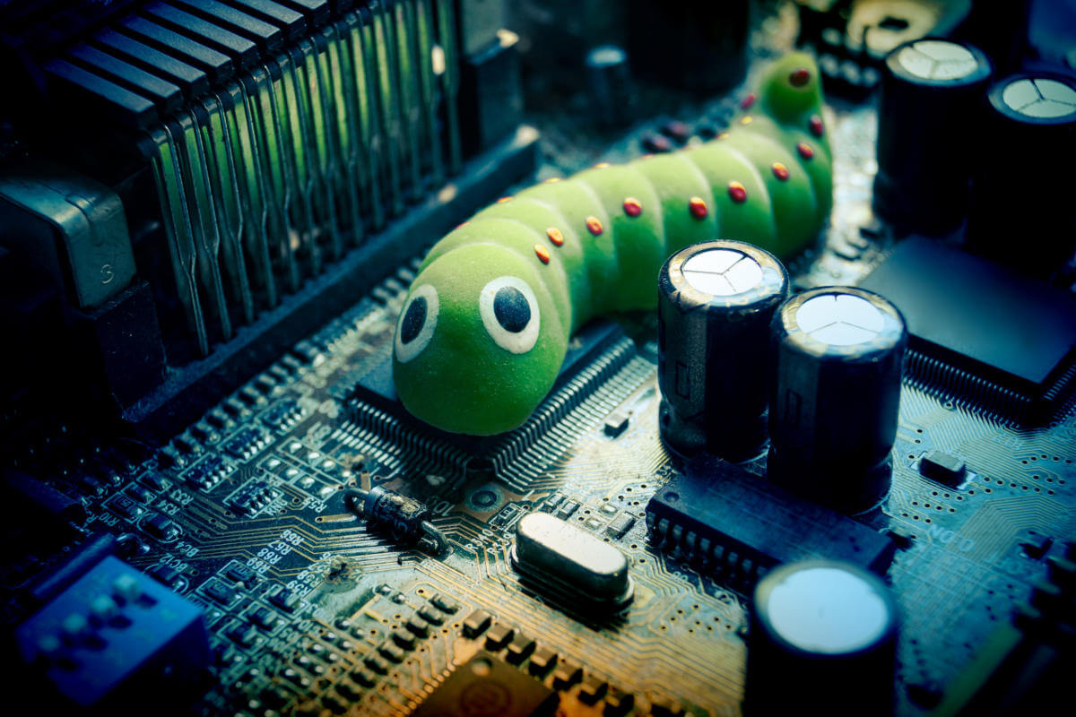
Worm
A computer worm is a type of malware that can automatically propagate or self-replicate without human interaction, enabling its spread to other computers across a network. A worm often uses the victim organization’s internet or a local area network (LAN) connection to spread itself.
A worm can destroy a system by using its resources to extreme levels. It can generate multiple copies which claim all the resources and don't allow any other processes to access them. A worm can shut down a whole network in this way.

Slide 18
Signs of a worm infection
Slow system performance stemming from high CPU resource usage
Hidden or missing files and folders
Emails sent to your contacts without your awareness
Computer programs crashing without warning
Mysterious files or programs that you didn’t install on the computer
Programs running or websites launching automatically
Unusual browser performance or program behavior

Slide 19
Denial of Service
A Denial-of-Service (DoS) attack is an attack meant to shut down a machine or network, making it inaccessible to its intended users. DoS attacks accomplish this by flooding the target with traffic, or sending it information that triggers a crash. In both instances, the DoS attack deprives legitimate users (i.e. employees, members, or account holders) of the service or resource they expected.
Victims of DoS attacks often target web servers of high-profile organizations such as banking, commerce, and media companies, or government and trade organizations. Though DoS attacks do not typically result in the theft or loss of significant information or other assets, they can cost the victim a great deal of time and money to handle.

Slide 20
Denial of Service
There are two general methods of DoS attacks: flooding services or crashing services. Flood attacks occur when the system receives too much traffic for the server to buffer, causing them to slow down and eventually stop. Popular flood attacks include:

Slide 21
Buffer overflow attack
It is the most common DoS attack. The concept is to send more traffic to a network address than the programmers have built the system to handle. It includes the attacks listed below, in addition to others that are designed to exploit bugs specific to certain applications or networks

Slide 22
ICMP flood
It leverages misconfigured network devices by sending spoofed packets that ping every computer on the targeted network, instead of just one specific machine. The network is then triggered to amplify the traffic. This attack is also known as the smurf attack or ping of death.

Slide 23
SYN flood
It sends a request to connect to a server, but never completes the handshake. Continues until all open ports are saturated with requests and none are available for legitimate users to connect to.

Slide 24
Other DoS attacks
Other DoS attacks simply exploit vulnerabilities that cause the target system or service to crash. In these attacks, input is sent that takes advantage of bugs in the target that subsequently crash or severely destabilize the system, so that it can’t be accessed or used.

Slide 25
Distributed Denial of Service (DDoS) attack
An additional type of DoS attack is the Distributed Denial of Service (DDoS) attack. A DDoS attack occurs when multiple systems orchestrate a synchronized DoS attack to a single target. The essential difference is that instead of being attacked from one location, the target is attacked from many locations at once.

Slide 26
Distributed Denial of Service (DDoS) attack
The distribution of hosts that defines a DDoS provide the attacker multiple advantages:
The attacker can leverage the greater volume of machine to execute a seriously disruptive attack.
The location of the attack is difficult to detect due to the random distribution of attacking systems (often worldwide)
It is more difficult to shut down multiple machines than one
The true attacking party is very difficult to identify, as they are disguised behind many (mostly compromised) systems.

Slide 27
Protection and Security Methods
The different methods that may provide protect and security for different computer systems are:

Slide 28
Authentication
This deals with identifying each user in the system and making sure they are who they claim to be. The operating system makes sure that all the users are authenticated before they access the system. The different ways to make sure that the users are authentic are:

Slide 29
Username/ Password
Username and password authentication is a method of verifying the identity of a user accessing a digital system. The user provides a unique identifier, called a username, and a secret, called a password, to gain access. The system then compares this information with its stored database to verify the user's identity.
Username and password authentication is a fundamental and widely used method of verifying the identity of users accessing online systems, websites, and applications.

Slide 30
Username/ Password
It serves as a crucial line of defense against unauthorized access and protects sensitive information from falling into the wrong hands. The primary purpose of username and password authentication is to ensure that only authorized individuals with valid credentials can access restricted resources.

Slide 31
Smart User Card / User Key
A smart card is a physical device, usually a plastic card with a microprocessor, that can provide personal authentication using certificates stored on the card. Personal authentication means that you can use smart cards in the same way as user passwords.
Authentication based on smart cards is an alternative to passwords. You can store user credentials on a smart card in the form of a private key and a certificate, and special software and hardware is used to access them. You place the smart card into a reader or a USB socket and supply the PIN code for the smart card instead of providing your password.

Slide 32
User Attribute Identification
Different user attribute identifications that can be used are fingerprint, eye retina etc. These are unique for each user and are compared with the existing samples in the database. The user can only access the system if there is a match.

Slide 33
One Time Password
These passwords provide a lot of security for authentication purposes. A one-time password can be generated exclusively for a login every time a user wants to enter the system. It cannot be used more than once. The various ways a one-time password can be implemented are:

Slide 34
Random Numbers
The system can ask for numbers that correspond to alphabets that are pre-arranged. This combination can be changed each time a login is required.

Slide 35
Secret Key
A hardware device can create a secret key related to the user id for login. This key can change each time.

Slide 36
Thank you for listening to me.

