Slide 1
Operatıng Systems
H.Bodur

Slide 2
Process Management
Process: A process or task is an instance of a program in execution. The execution of a process must programs in a sequential manner. At any time at most one instruction is executed. The process includes the current activity as represented by the value of the program counter and the content of the processor’s registers. Also, it includes the process stack which contain temporary data (such as method parameters return address and local variables) & a data section which contain global variables.

Slide 3
Difference between process & program
A program by itself is not a process. A program in execution is known as a process. A program is a passive entity, such as the contents of a file stored on disk where as process is an active entity with a program counter specifying the next instruction to execute. A set of associated resources may be shared among several process with some scheduling algorithm being used to determinate when the stop work on one process and service a different one.

Slide 4
Difference between process & program
Process state: As a process executes, it changes state. The state of a process is defined by the correct activity of that process. Each process may be in one of the following states.
New: The process is being created.
Ready: The process is waiting to be assigned to a processor.
Running: Instructions are being executed.
Waiting: The process is waiting for some event to occur.
Terminated: The process has finished execution.
It is important: Many processes may be in ready and waiting state at the same time. But only one process can be running on any processor at any instant.

Slide 5
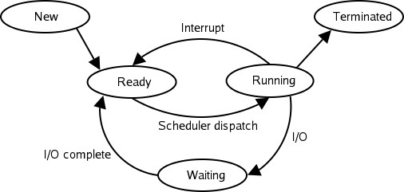
Process state

Slide 6
Process scheduling
Scheduling is a fundamental function of OS. When a computer is multiprogrammed, it has multiple processes completing for the CPU at the same time. If only one CPU is available, then a choice has to be made regarding which process to execute next. This decision-making process is known as scheduling and the part of the OS that makes this choice is called a scheduler or process manager. The algorithm it uses in making this choice is called scheduling algorithm.
Scheduling queues: As processes enter the system, they are put into a job queue. This queue consists of all process in the system. It is called ready queue.

Slide 7
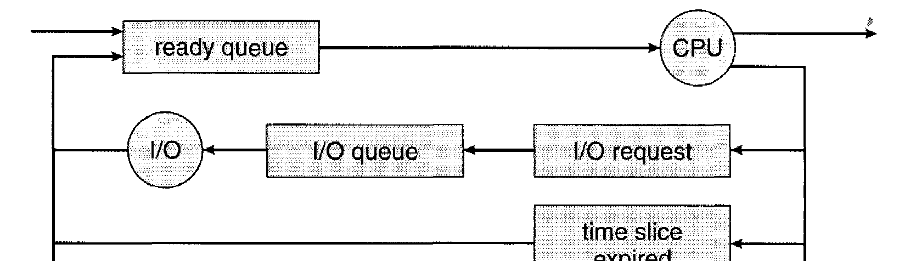

Process scheduling

Slide 8
PROCESS
This queue is generally stored as a linked list. A ready queue header contains pointers to the first & final Process Control Blok (PCB) in the list. The PCB includes a pointer field that points to the next PCB in the ready queue.
A process may terminate after running. Or the process may request input and output operation. In this case, the process is added to the I/O queue. After the input and output operation is completed, the process is added to the ready queue again. Or while the process running, an interruption may occur. If there is any interruption, the process stops running and the CPU handles the interruption. Or a process runs out of time. It is added again to the end of the ready queue.

Slide 9
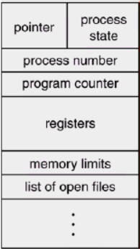
Process Control
The information required for each process to run is shown in the task control block (PCB=Process Control Block).

Slide 10
Information about each process
Program counter: It indicates the address of the next instruction to be executed for this purpose.
CPU registers: The registers vary in number & type depending on the computer architecture. It includes accumulators, index registers, stack pointer & general purpose registers, plus any condition code information must be saved when an interrupt occurs to allow the process to be continued correctly afterward.
CPU scheduling information: It includes process priorities, scheduling parameters.

Slide 11
Information about each process
Memory management information: This information may include such information as the value of the bar & limit registers, the page tables or the segment tables, depending upon the memory system used by the operating system.
Statistical information: This information includes the amount of CPU and real time used, time limits, account number, job or process numbers and so on.

Slide 12
Information about each process
I/O status information: This information includes the list of I/O devices allocated to this process, a list of open files and so on. The PCB simply serves as the repository for any information that may vary from process to process.

Slide 13
Schedulers
A process migrates between the various scheduling queues throughout its life-time purposes. The OS must select for scheduling processes from these queues in some fashion. This selection process is carried out by the appropriate scheduler.
There are 3 types of schedulers mainly used:

Slide 14
1.Long term scheduler
Long term scheduler selects process from the disk & loads them into memory for execution. It controls the degree of multi-programming i.e. count of processes in memory. It executes less frequently than other schedulers. If the degree of multiprogramming is stable than the average rate of process creation is equal to the average departure rate of processes leaving the system. So, the long-term scheduler is needed to be invoked only when a process leaves the system.

Slide 15
2. Short-term scheduler
The short-term scheduler selects among the process that are ready to execute & allocates the CPU to one of them. The primary distinction between these two schedulers is the frequency of their execution. The short-term scheduler must select a new process for the CPU quite frequently. It must execute at least one in 100ms. Due to the short duration of time between executions, it must be very fast. The ready queue is an example of a short-term scheduler.

Slide 16
3. Medium-term scheduler
Some operating systems introduce an additional intermediate level of scheduling known as medium - term scheduler. The main idea behind this scheduler is that sometimes it is advantageous to remove processes from memory & thus reduce the degree of multiprogramming. At some later time, the process can be reintroduced into memory & its execution can be continued from where it had left off. This is called as swapping.

Slide 17
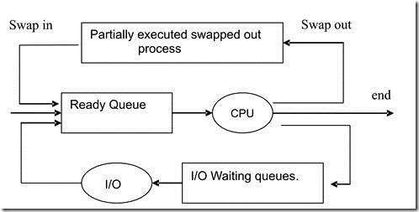

Slide 18
CPU Scheduling Algorithm
CPU Scheduling deals with the problem of deciding which of the processes in the ready queue is to be allocated first to the CPU. There are four types of CPU scheduling that exist.

Slide 19
1.First Come, First Served Scheduling (FCFS) Algorithm
This is the simplest CPU scheduling algorithm. In this scheme, the process which requests the CPU first, that is allocated to the CPU first. The implementation of the FCFS algorithm is easily managed with a FIFO queue. When a process enters the ready queue, its PCB is linked onto the rear of the queue. The average waiting time under FCFS policy is quiet long.

Slide 20
2.Shortest Job First Scheduling (SJF) Algorithm
It is aimed to prioritize the process with the shortest remaining operating time to exit the system as soon as possible and thus obtain the shortest average waiting time. If the remaining times of two processes are the same, then the FCFS algorithm is applied.
In this algorithm, each process is evaluated with the next CPU processing time of that process. This is used to find the shortest time job. SJF optimizes for the smallest average waiting time for a given set of processes.
There are two types.

Slide 21
2.Shortest Job First Scheduling (SJF) Algorithm
1. Uninterrupted SJF: If CPU is allocated to a process, the process cannot be interrupted until the CPU processing time expires.
2. Interrupted SJF: If a new process is presented to the system whose CPU processing time is less than the remaining processing time of the currently running process, the old process will be interrupted. This method is called SRTF (Shortest Remaining Time First) method.

Slide 22
3.Priority Scheduling Algorithm
In this scheduling a priority is associated with each process and the CPU is allocated to the process with the highest priority. Equal priority processes are scheduled in FCFS manner.

Slide 23
4.Round Robin Scheduling Algorithm
Each process has t milliseconds. The process manager, which is switched to CPU with clock alerts arriving every t millisecond, adds the currently running process to the end of the ready queue. It switches the process at the head of the queue to CPU to run after it. If there are n processes, the processes arrive in n*t time. Processes can also terminate before t. t time should be chosen carefully. If it is chosen short, the process manager will use the CPU too much; if it is selected long, the frequency of processes and interactive processing performance will decrease.

Slide 24
5.Multi-Tailed Algorithm
A multi-tail algorithm is used to combine the positive aspects of different scheduling algorithms and reduce their drawbacks. In the multi-queue algorithm, processes waiting to be switched to the CPU are connected to separate queues according to the type of process, instead of a common ready queue. A separate algorithm is used for each of multiple queues. (Because some of the processes are high priority, some are interactive, some are large) According to this algorithm, the processes in the high priority queue are processed first. If this resource is empty, lower-level processes can be executed.

Slide 25
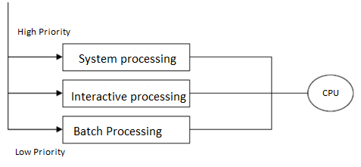

Slide 26
Threads
Running programs are called tasks. Parallel executable segments within a program are called threads. In this context, the task is considered as a common operating environment in which the relevant operating threads run.
Threads are discrete scheduled flows of processes. Windows systems schedule on a thread basis. The operating system keeps the threads of all processes in a schedule and runs them in a time-sharing manner. A thread is run for a while and then its execution is paused. Another thread continues to run where it left off. The programmer may think that his thread runs continuously, but in fact the flow is run in pieces.

Slide 27
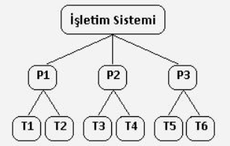
Threads
For example, the operating system runs the T1 thread of the Process 1 for 10ms, then stores the remaining position, this time it moves to the T2 thread of the Process 1. Then, the threads of the Process 2 task and the Process 3 task are run in the same way. It starts again and the process continues. In systems with more than one microprocessor (IntelDualCore), the operating system creates a separate schedule for each processor and provides faster operation. The operating system assigns threads to processors.

Slide 28
Cooperating Process
In the operating system there are two types of processes:
Independent Process: Independent Processes are those processes whose task is not dependent on any other processes.
Cooperating Process: Concurrent processes executing in the operating system allows for the processes to cooperate with other processes. Processes are cooperating if they can affect each other. The simplest example of how this can happen is where two processes are using the same file. One process may be writing to a file, while another process is reading from the file; so, what is being read may be affected by what is being written. Processes cooperate by sharing data. These processes interact with each other by sharing the resources such as CPU, memory, and I/O devices to complete the task.

Slide 29
Cooperation is important for several reasons
Information sharing: Several processes may need to access the same data (such as stored in a file.)
Computation speedup: A task can ofter be run faster if it is broken into subtasks and distributed among different processes.
Modularity: It may be easier to organize a complex task into separate subtasks, then have different processes or threads running each subtask.
Convenience: An individual user can run several programs at the same time, to perform some task.

Slide 30
The concept of cooperating processes
Inter-Process Communication (IPC): Cooperating processes interact with each other via Inter-Process Communication (IPC). As they are interacting to each other and sharing some resources with another so running task get the synchronization and possibilities of deadlock decreases. To implement the IPC there are many options such as pipes, message queues, semaphores, message passing, FIFO, indirect communication, direct communication and shared memory.

Slide 31
The concept of cooperating processes
Concurrent execution: These cooperating processes executes simultaneously which can be done by operating system scheduler which helps to select the process from ready queue to go to the running state. Because of concurrent execution of several processes the completion time decreases.

Slide 32
The concept of cooperating processes
Resource sharing: In order to do the work, cooperating processes cooperate by sharing resources including CPU, memory, and I/O hardware. If several processes are sharing resources as if they have their turn, synchronization increases as well as the response time of process increase.

Slide 33
The concept of cooperating processes
Deadlocks: As cooperating processes shares their resources, there might be a deadlock condition. Deadlock means if p1 process holds the resource A and wait for B and p2 process hold the B and wait for A. In this condition deadlock occur in cooperating process. To avoid deadlocks, operating systems typically use algorithms such as the Banker’s algorithm to manage and allocate resources to processes.

Slide 34
The concept of cooperating processes
Process scheduling: Cooperating processes runs simultaneously but after context switch, which process should be next on CPU to executes, this is done by the scheduler. Scheduler do it by using several scheduling algorithms such as Round-Robin, FCFS, SJF, Priority etc.
In conclusion, cooperating processes are essential unit to increase the concurrent execution and because of it, the performance of the overall system increases.

Slide 35
Homework
Let's explain the methods and approaches that can be used in IPC synchronization and implementation.

